Slide 1
Stem Cells

Slide 2
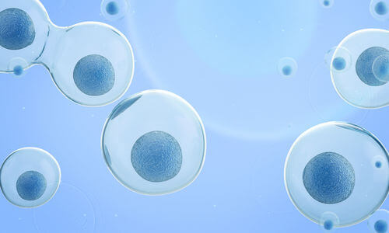
In this Smart Lesson, you will be doing the following:
1. | Defining the term stem cell.
2. | Describing the purpose of adult stem cells in a healthy body.
3. | Comparing and contrasting adult and embryonic stem cells.

Slide 3
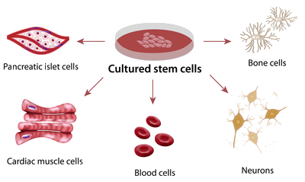
Stem cells are also called undifferentiated cells.
Differentiation is the process by which stem cells become specialised cells.

Slide 4

Stem cells can divide into two by the process of mitosis.
Remember, mitosis is the type of cell division that produces two identical cells.
Stem cells can either continue dividing into more stem cells, or they can differentiate into more specialised cells.

Slide 5
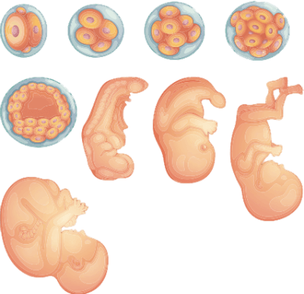
There are two types of stem cells.
The source of the stem cell determines the number of different specialised cells that it can become.
Pluripotent or embryonic stem cells are those that can become any type of cell in the body. They are found in embryos that are just a few days old.

Slide 6
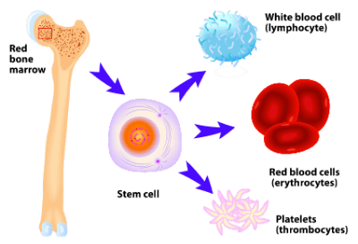
Tissue-specific or adult stem cells are found in specific adult tissues and organs.
They can become any of the cell type of the tissue that they are found in. For example, the stem cells found in bone marrow can become any type of blood cell, but they can't become muscle or brain cells.

Slide 7
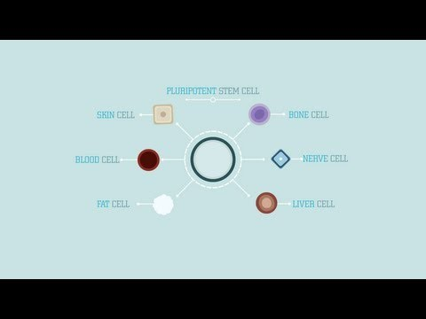

Slide 8
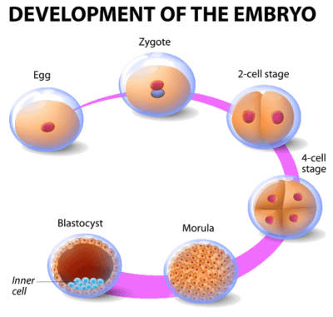
Remember: everyone started out as a single cell that then divided into more cells to make a person.
This person is an extremely complex multicellular organism with many specialised tissues and organs. Stem cells are essential during development to form these specialised tissues from unspecialised cells.

Slide 9
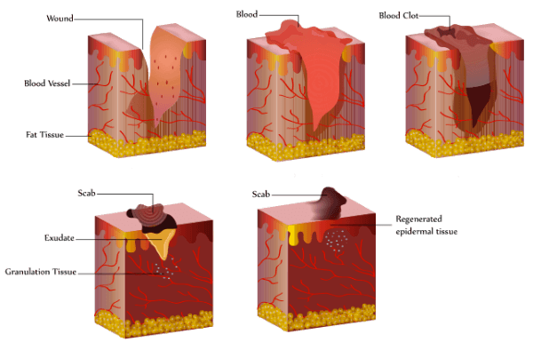
After the organism develops, these pluripotent stem cells are no longer present.
However, certain tissue types have groups of tissue-specific stem cells. These cells are used to replace damaged cells in those tissues.

Slide 10
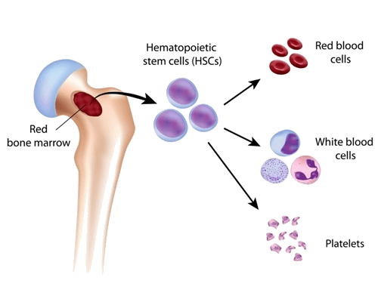
Tissue-specific stem cells can be found in various parts of a healthy body.
Stem cells have been found in the bone marrow, brain, blood vessels, skeletal muscle, skin, teeth, heart, gut, liver, and other places (but not all tissues).
They remain in the tissue until they are activated by certain factors such as chemicals released from injured tissue. This can be from normal wear and tear or disease, and it triggers them to differentiate into new cells.

Slide 11
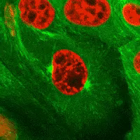
When the stem cells are triggered, they begin to differentiate.
For example, if your skin cells are damaged, stem cells below the layers of your skin can differentiate into skin cells to replace these cells.

Slide 12
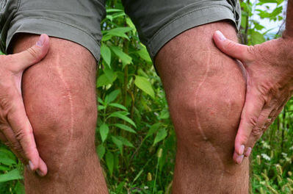
As you probably know, the natural capabilities of stem cells to repair our damaged tissues are limited.
If you cut your skin too deep, a scar will form rather than the wound healing perfectly.
Scientists are excited about the possibility of activating or adding extra stem cells to reduce the formation of scars and to treat other injuries and diseases.

Slide 13
